Slide 2
EVMS (Earned Value Management System) CHART

Slide 3
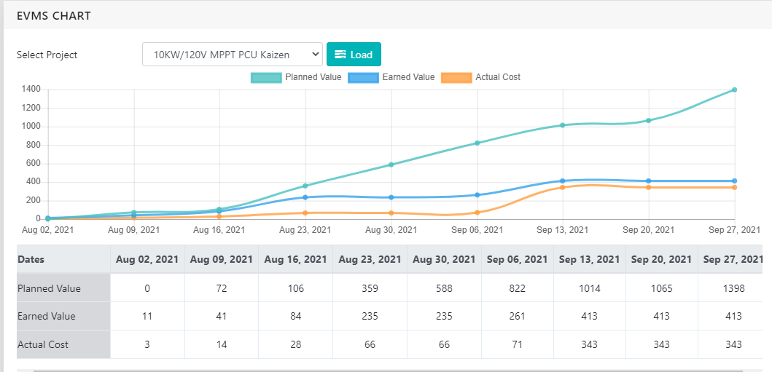
10KW MPPT PCU : EVMS Chart & Interpretation
EV is below PV, that means project is delay.
AC is below EV, that means team is working more efficiently than expected.
PV is far above from EV and AC, that means there is planning error, during planning efforts considered too much but actually very less efforts showing.
There may be timesheets by team members not loading.
From 13th Sep. to 27th Sep.21 the EV & AC curve is flat, it means now work done (no efforts loaded) during this period, due to may be other projects / other tasks etc.

Slide 4
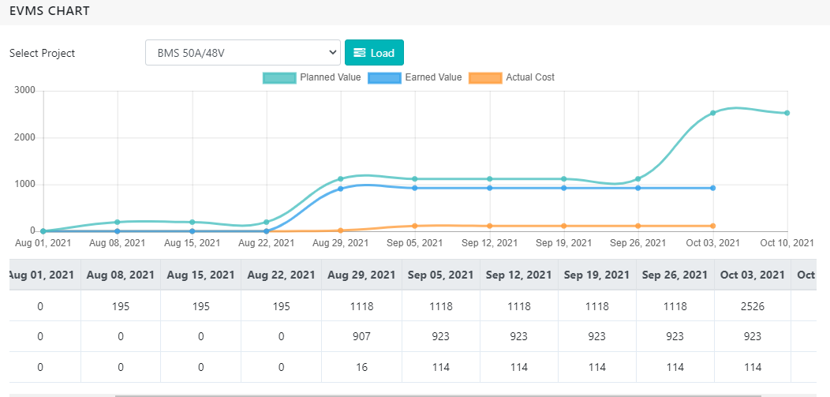
BMS 50A / 48V : EVMS Chart & Interpretation
EV is below PV, that means project is delay.
AC is below EV. With almost negligible values that means team working is very less on this project.
PV is far above from AC, that means there may be timesheets by team members not loading.
From 5th Sep. to 3rd Oct.21 the EV & AC curve is flat, it means now work done (no efforts loaded) during this period, due to may be other projects / other tasks etc.
Overall curve showing that project is on hold.

Slide 5
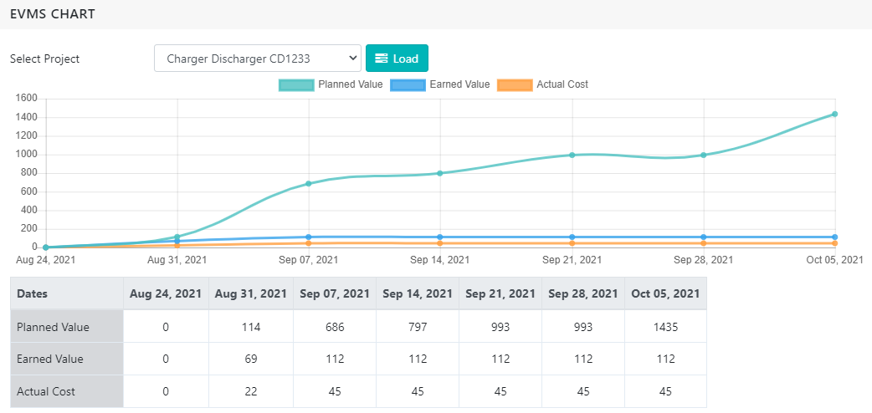
Charger Discharger CD1233 : EVMS Chart & Interpretation
EV is below PV, that means project is delay.
AC is below EV. With almost negligible values that means team working is very less on this project.
PV is far above from AC, that means there may be timesheets by team members not loading.
From 7th Sep. to 5th Oct.21 the EV & AC curve is flat, it means now work done (no efforts loaded) during this period, due to may be other projects / other tasks etc.
Overall curve showing that project is on hold.

Slide 6
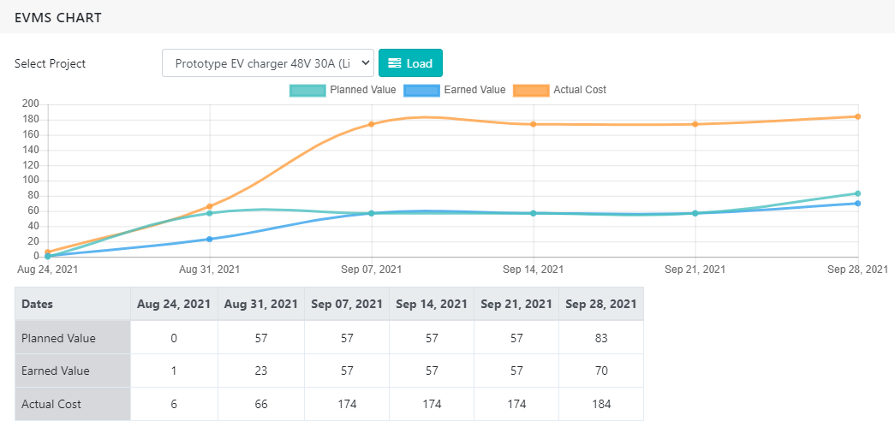
Prototype EV Charger 48V 30A (Li-ion) : EVMS Chart & Interpretation
EV is below PV, that means project is delay.
AC is above EV. the team is working less efficiently than expected (or are stuck solving an unexpected issue).
The efforts spent are higher than planned (AC above PV), so the project manager may be killing his team members to catch up, but they still can’t; or are stuck in an unexpected issue.
From 14th Sep. to 21st Sep.21 the EV & AC curve is flat, it means now work done (no efforts loaded) during this period, due to may be other projects / other tasks etc.
Overall curve showing that project is near to hold or stuck at one place due to either any unexpected issue or priority given to other projects.

